Slide 1

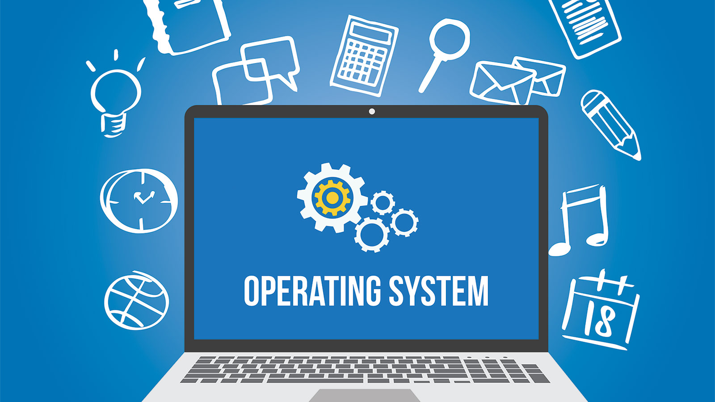
Operating system

Slide 2
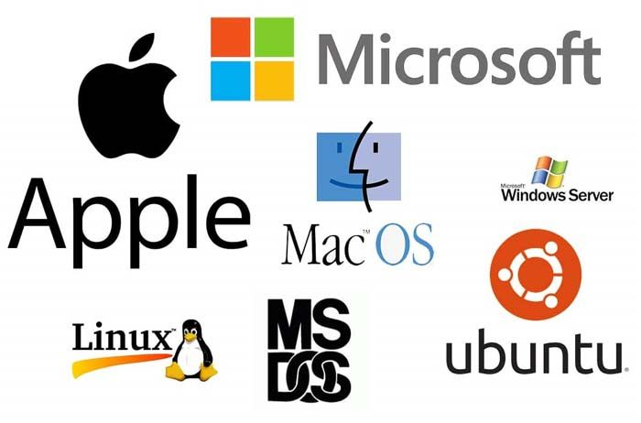
What is an Operating System
Introduction:
"An operating system (OS) is a crucial software component that acts as an intermediary between computer hardware and users. It facilitates efficient communication and coordination between various hardware components and allows users to interact with the computer.“
Importance of an Operating System:
"Operating systems are the backbone of modern computing, providing a platform for applications to run and enabling users to interact with computers. They manage resources, ensure security, and play a pivotal role in overall system functionality.

Slide 3
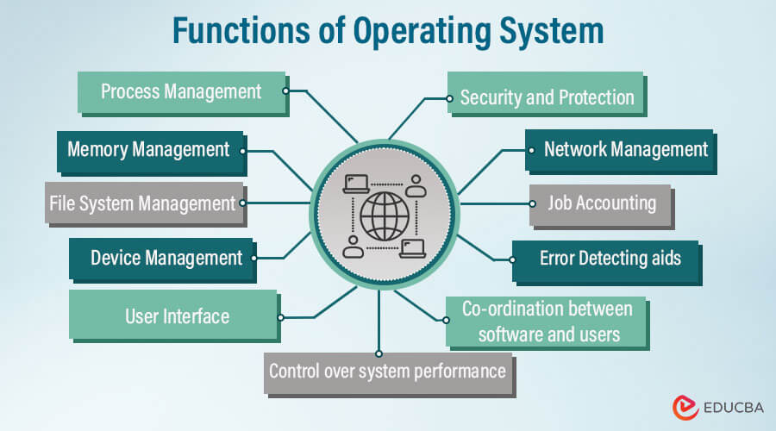
Overview of Key Functions::
Resource Management
Process Management
Memory Management
File System Management
User Interface
Device Management

Slide 4
RESOURCE MANAGEMENT
“Resource management is a fundamental function of the operating system, ensuring optimal utilization of computer resources.”
IMPORTANCE OF RESOURCE MANAGEMENT :-
Optimized Performance:
Efficient resource management ensures that the computer system operates at its maximum potential, leading to faster response times for user commands and improved overall performance. This optimization is crucial for providing a seamless user experience.
Multitasking Support:
Resource management enables the operating system to handle multiple tasks simultaneously. By allocating CPU time, memory, and other resources to different processes, users can run multiple applications concurrently, enhancing productivity and usability.
Prevention of Resource Exhaustion and System Stability:
Resource management prevents resource exhaustion, which could lead to system slowdowns, crashes, or unresponsiveness. Proper allocation and deallocation of resources contribute to system stability, reliability, and prevent issues caused by conflicts among competing processes.

Slide 5
PROCESS MANAGEMENT
“Process management is a critical function of the operating system that oversees the creation, scheduling, and termination of processes.”
IMPORTANCE OF PROCESS MANAGEMENT
Optimized System Utilization:
Efficient process management ensures that the CPU is utilized to its full capacity, preventing idle time and enhancing overall system efficiency.
Responsive System Behavior:
Effective scheduling and prioritization contribute to a responsive system that quickly adapts to user inputs and executes tasks promptly.
Resource Utilization Fairness:
Ensures fair distribution of CPU time and resources among competing processes, preventing any single process from monopolizing system resources.

Slide 6
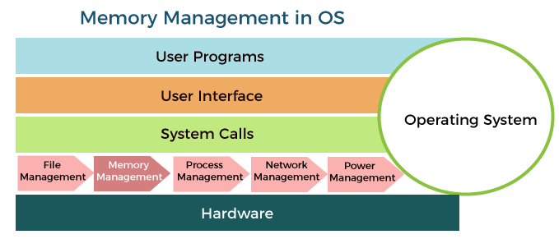
MEMORY MANAGEMENT
“Memory management is a crucial aspect of operating systems, involving the control and organization of computer memory. The operating system ensures efficient storage, retrieval, and allocation of data in the computer's memory.”
IMPORTANCE OF MEMORY MANAGEMENT
Prevention of Overflows and Crashes:
Effective memory management prevents buffer overflows and memory leaks, which can lead to system crashes and instability.
Optimized Application Performance:
Ensures that applications have access to the required memory for efficient execution, enhancing overall system and application performance.
Virtual Memory for Enhanced Capacity:
The use of virtual memory allows the execution of larger programs and facilitates the smooth operation of multiple applications simultaneously

Slide 7
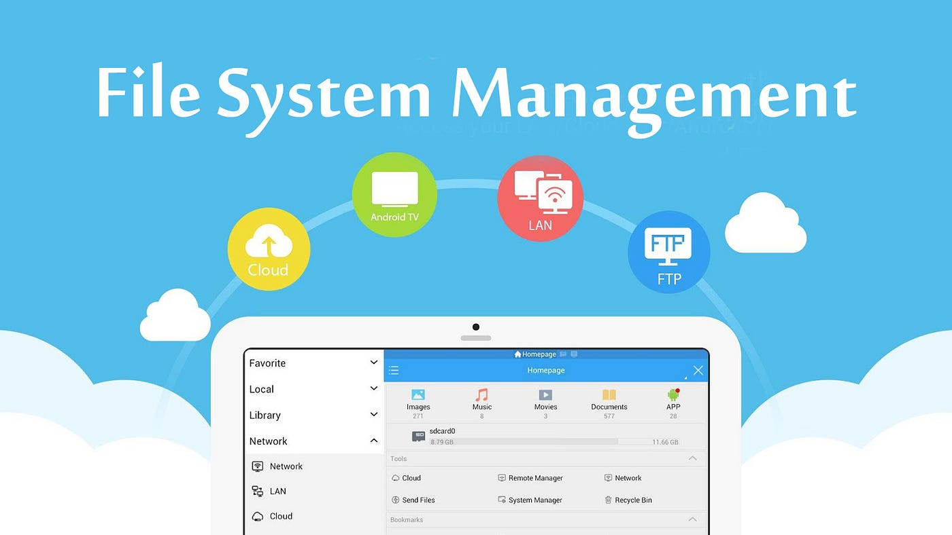
FILE SYSTEM MANAGEMENT
“File system management is a core function of the operating system that involves organizing and controlling the storage, retrieval, and manipulation of files on the computer.”
IMPORTANCE OF FILE SYSTEM MANAGEMENT
Data Organization and Retrieval:
Efficient file organization enables quick and easy retrieval of data, contributing to a streamlined user experience.
Data Security:
Enforces security measures to protect files from unauthorized access, ensuring the confidentiality and integrity of data.
Application Interaction:
Allows applications to interact with files in a standardized manner, promoting compatibility and ease of use.

Slide 8
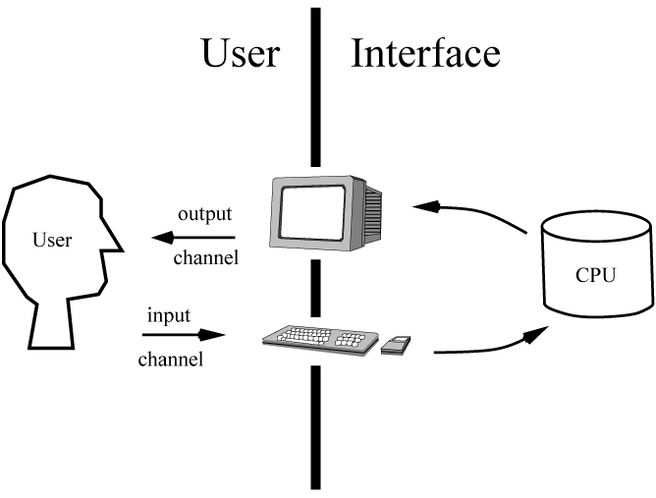
USER INTERFACE
“The user interface (UI) is the point of interaction between the user and the computer. Operating systems provide various types of interfaces to accommodate different user preferences and needs.”
IMPORTANCE OF USER INTERFACE
User-Friendly Interactions:
GUIs enhance user-friendliness, allowing users to interact with the system through visual elements, reducing the learning curve for new users.
Efficiency in Command Execution:
CLI provides experienced users with a fast and efficient way to execute commands, especially in scenarios where precise control is required.
Accessibility for Diverse Users:
The availability of different interfaces caters to a diverse user base, accommodating both those who prefer a graphical environment and those who are comfortable with command-line operations.

Slide 9
DEVICE MANAGEMENT
“Device management is a critical aspect of the operating system that involves controlling and coordinating communication with hardware devices, ensuring their proper functioning.”
IMPORTANCE OF DEVICE MANAGEMENT
Ensuring Device Compatibility:
Device management ensures that hardware devices are compatible with the operating system, allowing users to seamlessly connect and use a variety of peripherals.
Optimal Device Performance:
By managing device drivers and I/O operations, the operating system contributes to the optimal performance of hardware devices.
Facilitating Peripheral Interactions:
Device management facilitates interactions with peripherals such as printers, keyboards, and storage devices, enhancing the overall functionality of the computer system.

Slide 10
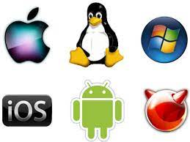
TYPES OF OPERATING SYSTEMS :-
Operating systems come in various types, each designed to meet specific needs and preferences. Understanding these types provides insights into the diverse landscape of operating systems.
Major Types:
Windows Operating System:
Developed by Microsoft, Windows is one of the most widely used operating systems, known for its user-friendly interface and broad application compatibility.
macOS:
Exclusive to Apple's hardware, macOS is known for its sleek design, performance optimization, and seamless integration with Apple devices.
Linux Operating System:
Linux is an open-source operating system kernel widely used in various distributions (distros). Known for its stability, security, and versatility, it powers a range of systems, from servers to embedded devices.
Unix Operating System:
A powerful and stable operating system used in server environments and large-scale computing. It has influenced the development of Linux and other operating systems.
Mobile Operating Systems (Android, iOS):
Android, developed by Google, and iOS, developed by Apple, are dominant mobile operating systems. They power smartphones and tablets, providing app ecosystems and user-friendly interfaces.

Slide 11
COMPONENTS OF OPERATING SYSTEM :-
Kernel: Core of the Operating System:
The kernel is the central component of the operating system, responsible for managing essential system functions, including memory management, process scheduling, and device communication.
Shell: Interface Between the User and the Kernel:
The shell is the user interface that allows interaction with the operating system. It interprets user commands and communicates them to the kernel for execution.
Libraries, Device Drivers, and System Utilities:
Libraries:
Collections of precompiled code that provide essential functions to applications. They enhance efficiency by enabling developers to reuse code.
Device Drivers:
Software components that enable communication between the operating system and hardware devices. They facilitate the translation of high-level commands into actions the hardware can execute.
System Utilities:
Tools and applications that assist in managing and maintaining the operating system. Examples include disk cleanup tools, task managers, and system configuration utilities.

Slide 12
IMPORTANCE OF EACH COMPONENT :-
Kernel:
Acts as the core decision-maker, coordinating all system activities.
Directly impacts the system's stability, performance, and responsiveness.
Shell:
Serves as the user's gateway to the system, allowing interaction with the kernel.
The design and functionality of the shell significantly influence the user experience.
Libraries, Device Drivers, and System Utilities:
Contribute to the overall functionality, efficiency, and usability of the operating system.
Enhance the capabilities of the system and provide essential tools for users and developers.

Slide 13
OS SECURITY :-
Importance of Security in Operating Systems:
Security is a paramount concern for operating systems, safeguarding data, user privacy, and system integrity. The implementation of robust security measures is crucial to protect against various threats.
Key Security Features and Measures:
1 ) User Authentication:
Ensures that only authorized users can access the system. This can involve passwords, biometrics, or other authentication methods.
2 )Access Controls:
Specifies what actions users or systems are allowed to perform. Different levels of access are granted based on user roles and permissions.
3 )Encryption:
Protects sensitive data by converting it into a secure, unreadable format. Encryption is essential for securing data during transmission and storage.
4 )Firewalls and Intrusion Detection Systems:
Firewalls monitor and control network traffic, preventing unauthorized access. Intrusion Detection Systems (IDS) identify and respond to suspicious activities.
5 )Regular Software Updates:
Timely updates and patches address vulnerabilities, enhancing the system's resilience against evolving security threats.

Slide 14
Challenges in Operating Systems
Addressing Security Vulnerabilities:
Continuous efforts are required to identify and address security vulnerabilities, with a focus on implementing updates, patches, and proactive security measures to counter emerging threats.
2.Compatibility Issues:
Integrating new hardware, software, or updates can lead to compatibility challenges. Ensuring seamless compatibility across diverse environments remains an ongoing concern for operating system developers.
Keeping Up with Technological Advancements:
Rapid technological advancements pose a challenge for operating systems to adapt quickly. Staying current with emerging technologies and integrating them seamlessly is an ongoing challenge.
Balancing Performance and Resource Management:
Striking a balance between optimal system performance and efficient resource management is crucial. Preventing resource-intensive tasks from compromising overall system responsiveness is an ongoing challenge.
User Interface Design Challenges:
Designing user interfaces that are both intuitive for beginners and efficient for power users presents a continual challenge. Balancing simplicity with functionality is crucial for a positive user experience.

Slide 15
Future Trends in Operating Systems
Cloud Computing Integration:
The integration of operating systems with cloud computing is a key future trend. This involves leveraging cloud resources for storage, processing power, and applications, leading to increased flexibility and scalability.
Impact of Internet of Things (IoT):
Operating systems are adapting to the growth of IoT, where interconnected devices communicate and share data. Future operating systems are likely to focus on efficient management and communication within IoT ecosystems.
Advances in Security Measures:
Anticipate continued advancements in security measures, including biometric authentication, AI-driven threat detection, and enhanced encryption techniques, to address evolving cybersecurity challenges.
Enhancements in Virtualization:
Virtualization technologies, such as containerization and virtual machines, will likely see continued enhancements. These technologies provide efficient resource utilization and isolation, contributing to improved system performance.
Evolution of Edge Computing:
Operating systems are expected to evolve to support edge computing, where processing power is decentralized and brought closer to the data source. This trend aims to reduce latency and improve real-time data processing.

Slide 16
THANK YOU

